Slide 1
Spring Enterprise Batch
Appreciating All Levels from the Surface to the Depth

Slide 2
Enterprise Batch Processing
Batch processing is used to process billions of transactions every day for enterprises.
EXAMPLE:
The Options Clearing Corporation[OCC] equity derivatives clearing house
EOD stats: – 12 MM/day - 360 MM per month - 4.2 Billion per year
OCC Batch Processing
Bulk processing of mission critical operations.
Time based events (e.g. month-end calculations, notices or correspondence)
periodic application of complex business rules processed repetitively
across enormous data sets
(e.g. Insurance benefit determination or rate adjustments)
Integration of information [formatting, validation and processing]
in a transactional manner into the system of record.
Modern Java batch applications make use of modern batch frameworks - implementations of JSR 352
Notes:
Daily batch processing
http://www.optionsclearing.com/market-data/batch-processing.jsp
OCC – 12 mm /day 360 MM per month 4.2 Billion per year

Slide 3
Modern Batch Processing
GOAL: Leverage in-house Developer skills for both online and batch processing
Maximum re-use of implementation.
Easier development and maintenance, as the same sets of tools are used.
Consistency in enforcement of enterprise standards and quality of service.
Modern Batch Processing :
Writing the business logic for the job
Separation of concern between the business logic and the “plumbing” code
More efficient modularization of batch functions – cultures re-use

Slide 4
Spring Batch Features
Transaction management
Chunk based processing
Declarative I/O
Statistics
Start/Stop/Restart
Retry/Skip
Web based administration interface (Spring Batch Admin)
Parallel processing & partitioning techniques to process high-volume of data.
Spring Batch
Notes:
Retry –example…record locked,
Skip not fatal error …skip limit

Slide 5
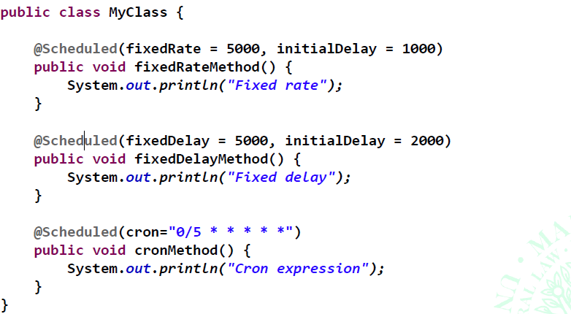
Spring Scheduling Annotation
FixedRate: Interval between method invocations measured from the start time of each invocation.
FixedDelay: interval between invocations measured from the completion of the task.
CRON expressions detailed task scheduling.

Slide 6
CRON Scheduling
The pattern is a list of six single space-separated fields:
second, minute, hour, day, month, weekday. Month and weekday
Example patterns:
"0 0 * * * *" = the top of every hour of every day.
"*/10 * * * * *" = every ten seconds.
"0 0 8-10 * * *" = 8, 9 and 10 o'clock of every day.
"0 0/30 8-10 * * *" = 8:00, 8:30, 9:00, 9:30 and 10 o'clock every day.
"0 0 9-17 * * MON-FRI" = on the hour nine-to-five weekdays
"0 0 0 25 12 ?" = every Christmas Day at midnight
CRON: Unix term for time-based job scheduler in Unix computer operating systems
cronExpression – Spring Version

Slide 7
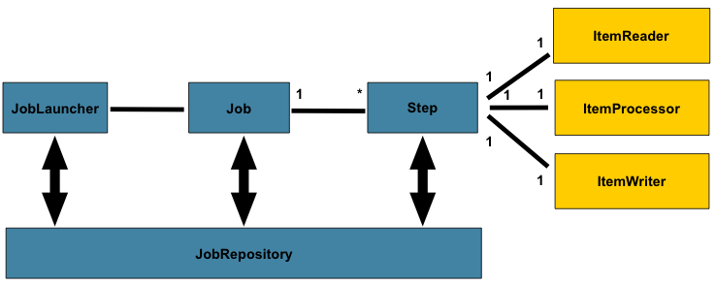
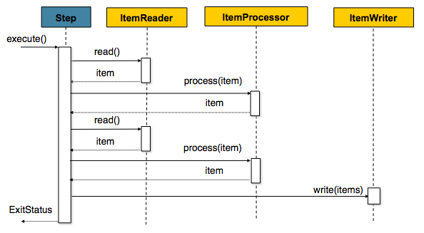
Basic Spring Batch Flow
Extract – Transform – Load
Notes:
A simple Step might load data from a file into the database, requiring little or no code. (depending upon the implementations used) A more complex Step may have complicated business rules that are applied as part of the processing.
Sub steps, parent steps

Slide 8
Basic ETL
Extract – Transform – Load
Item Reader, Processor & Writer
Item Reader [Extract]
Flat File- File records with fields of data defined by fixed positions in the file or
delimited by some special character (e.g. Comma).
XML - Input data allows for the validation of an XML file against an XSD schema.
Database – Map resultsets to objects for processing.
The default SQL ItemReaders invoke a RowMapper to return objects, keeps track of the current row if restart is required, store basic statistics…
Item Processor [Transform]
Interface for custom processing
Item Writer [Load]
Inverse operations of ItemReader
Readers-Writers

Slide 9
Job Declaration
Declare Reader [Extract] Bean:
id="csvFileReader" class="org.springframework.batch.item.file.FlatFileItemReader"
p:resource="classpath:data/products.csv">
Declare Mapper [Transform] Bean:
class=“…file.mapping.BeanWrapperFieldSetMapper"
p:targetType="edu.mum.domain.Product"/>
Declare Writer[Load] Bean:
id="productWriter"
class="edu.mum.batch.ProductItemWriter">
<beans:property name="productService">
<beans:bean class="edu.mum.service.impl.ProductServiceImpl"/>

Slide 10
Job Declaration [Cont.]
<job job-repository="jobRepository"
id="SaveProducts">
<step id="step1">
<tasklet ref="authenticate"/>
<next on="*" to="step2" />
</step>
<step id="step2">
<tasklet>
<chunk commit-interval="5" writer="productWriter"
reader="csvFileReader"/>
</tasklet>
</step>
</job>
Notes:
<batch:transaction-attributes …

Slide 11
Chunk based processing
Start transaction
Single item read with ItemReader [csvFileReader]
Processed by ItemProcessor [fieldSetMapper]
When # of items read == commit interval [5]
Write chunk with ItemWriter [productWriter]
Commit transaction
<chunk commit-interval="5" writer="productWriter"
reader="csvFileReader"/>
Notes:
https://terasoluna-batch.github.io/guideline/5.0.0.RELEASE/en/Ch02_SpringBatchArchitecture.html
Chunk size is increased to reduce overhead occurring due to resource output.
However, if chunk size is too large, it increases load on the resources resulting in deterioration in the performance. Hence, chunk size must be adjusted to a moderate value.

Slide 12
Error Handling
Skip, Retry, Restart
Skip Logic allows for handling an error that should not cause job failure. The item should be skipped instead. Log bad items for further analysis. [e.g. missing field in record]
Retry attempts an operation several times: the operation can fail at first, but another attempt can succeed.
Example: DB Lock
Restart the job at point of failure. The work performed by the previous execution isn’t lost.
For example, Skip [or Retry] have exceeded
preset limits

Slide 13
Skip Configuration
Skip up to 2 items [skip-limit], then throw job Failure exception
Skip for configured exceptions
<chunk commit-interval="5" writer="productWriter"
reader="csvFileReader" skip-limit="2">
<skippable-exception-classes>
<include class="java.lang.Exception"/>
</skippable-exception-classes>
</chunk>

Slide 14
Retry Configuration
Retry up to 3 times [retry-limit], then throw job Failure exception
Retry for configured exceptions
<chunk commit-interval="5" writer="productWriter"
reader="csvFileReader" retry-limit="3“ >
<retryable-exception-classes>
<include class="java.lang.Exception"/>
</retryable-exception-classes>
</chunk>

Slide 15
Restart Execution
// Get Failed job instance
JobInstance jobInstance = jobExecution.getJobInstance();
// Restart Job
restartId = jobOperator.restart(jobInstance.getId());
final JobExecution restartExecution =
jobExplorer.getJobExecution(restartId);

Slide 16
Spring Batch Testing Support
JobLauncherTestUtils
End-to-End Testing
Test the complete run of a batch job from beginning to end. This allows for a test that sets up a test condition, executes the job, and verifies the end result.
jobLauncherTestUtils.launchJob();
Individual Step Testing
For complex jobs, the end-to-end approach is unmanageable
Allows for targeted tests. Set up data for just that step and to validate its results directly.
jobLauncherTestUtils.launchStep("step2ETL");

Slide 17
Main Point
  Spring Batch provides a systematic, repeatable process for managing the “group dynamics” of large data sets.
  The Unified Field and it’s relative correlate the quantum field enhance group dynamics [1% effect]

